Slide 1
DELIRIUM IN PAEDIATRIC ICUS
CSC3068 - Silicone Valley Samurais
Notes:
Hello, and welcome to the presentation for our CSC3068 project regarding delirium within paediatric ICUS

Slide 2




OUR TEAM
Ewan Forsythe
Robbie Duncan
Adam Logan
Andrew Robb
Notes:
First off let's introduce the team, so starting from the left on the slide.

Slide 3
TABLE OF CONTENTS
01
02
03
04
05
INTRODUCTION
DESIGN
What is the problem?
What is our solution?
Our system design process, diagrams and documentation.
IMPLEMENTATION
DEMO
SUMMARY
Features implemented and reasons for prioritisation.
A live demonstration of our prototype system.
What we have covered in this demonstration
Notes:
Introduction:
Quick look at the problem and our proposed solution
Design:
Insight into our design process
Implementation:
What have we implemented
How we have prioritised
Demo:
A live runthrough of our prototype system
Summary:
Wrap-up of what we have covered in this session

Slide 4
01
Introduction

Slide 5
What is the problem?
Subject Overview
Delirium is a complex illness which only recently started to be recognised and diagnosed that can be found in both adults and children. It can affect a person's awareness of their surroundings, their behaviour and very quickly deteriorate a person’s mental state. Due to the nature of the symptoms of delirium and how rapidly it can develop means it can be difficult to diagnose especially in the younger and elderly generation.
The effects of this:
Currently the best solution now is to detox
Delirium can hinder a child's cognitive development
Can put inexperienced nurses in uncomfortable situations
What needs to be done:
A solid base for further research of treatments
Sharing of knowledge between Paediatric ICUs
Improved accessibility to education materials
Notes:
Subject Overview:
Delirium within PICUs is a complex illness with little understanding comparatively to its severity
Quickly deteriorate a person's mental state
It is a difficult illness to diagnose
Effects:
Delirium can damage a child’s cognitive development
The ambiguity of the illness can put nurses into uncomfortable situations
What needs to be done:
We need to create a universal base for research information on delirium
Develop the ability to share info between PICUs
As well as improved accessibility to education materials on this topic

Slide 6



What is the solution?
Solution Overview
This project is about delivering a software system to support a UK wide NHS clinical trial in the field of delirium in paediatric ICU. The trial is run from the QUB School of Nursing. Diagnosing and treating delirium is a poorly understood aspect of paediatric ICU medicine. This software system will include both an Audit functionality for research data and furthermore an e-learning environment for personal development of NHS staff.
Key Features:
User focused design
Accessibility considerations across our solution
Backend Database for data storage
Data Visualisation
Potential for Integrated E-Learning Packages
Notes:
Solution Overview:
Our proposed solution will be to provide a Software solution which supports the NHS with their research and understanding of Delirium, within PICUs
Across over 25 hospitals in the UK and Ireland
Both an Audit functionality for research data and an e-learning environment for personal development of NHS staff.
Key Features:
User focused design - Make it easy for NHS staff to use
Accessibility considerations across our solution
Data Visualisation

Slide 7
02
Design of the System

Slide 8
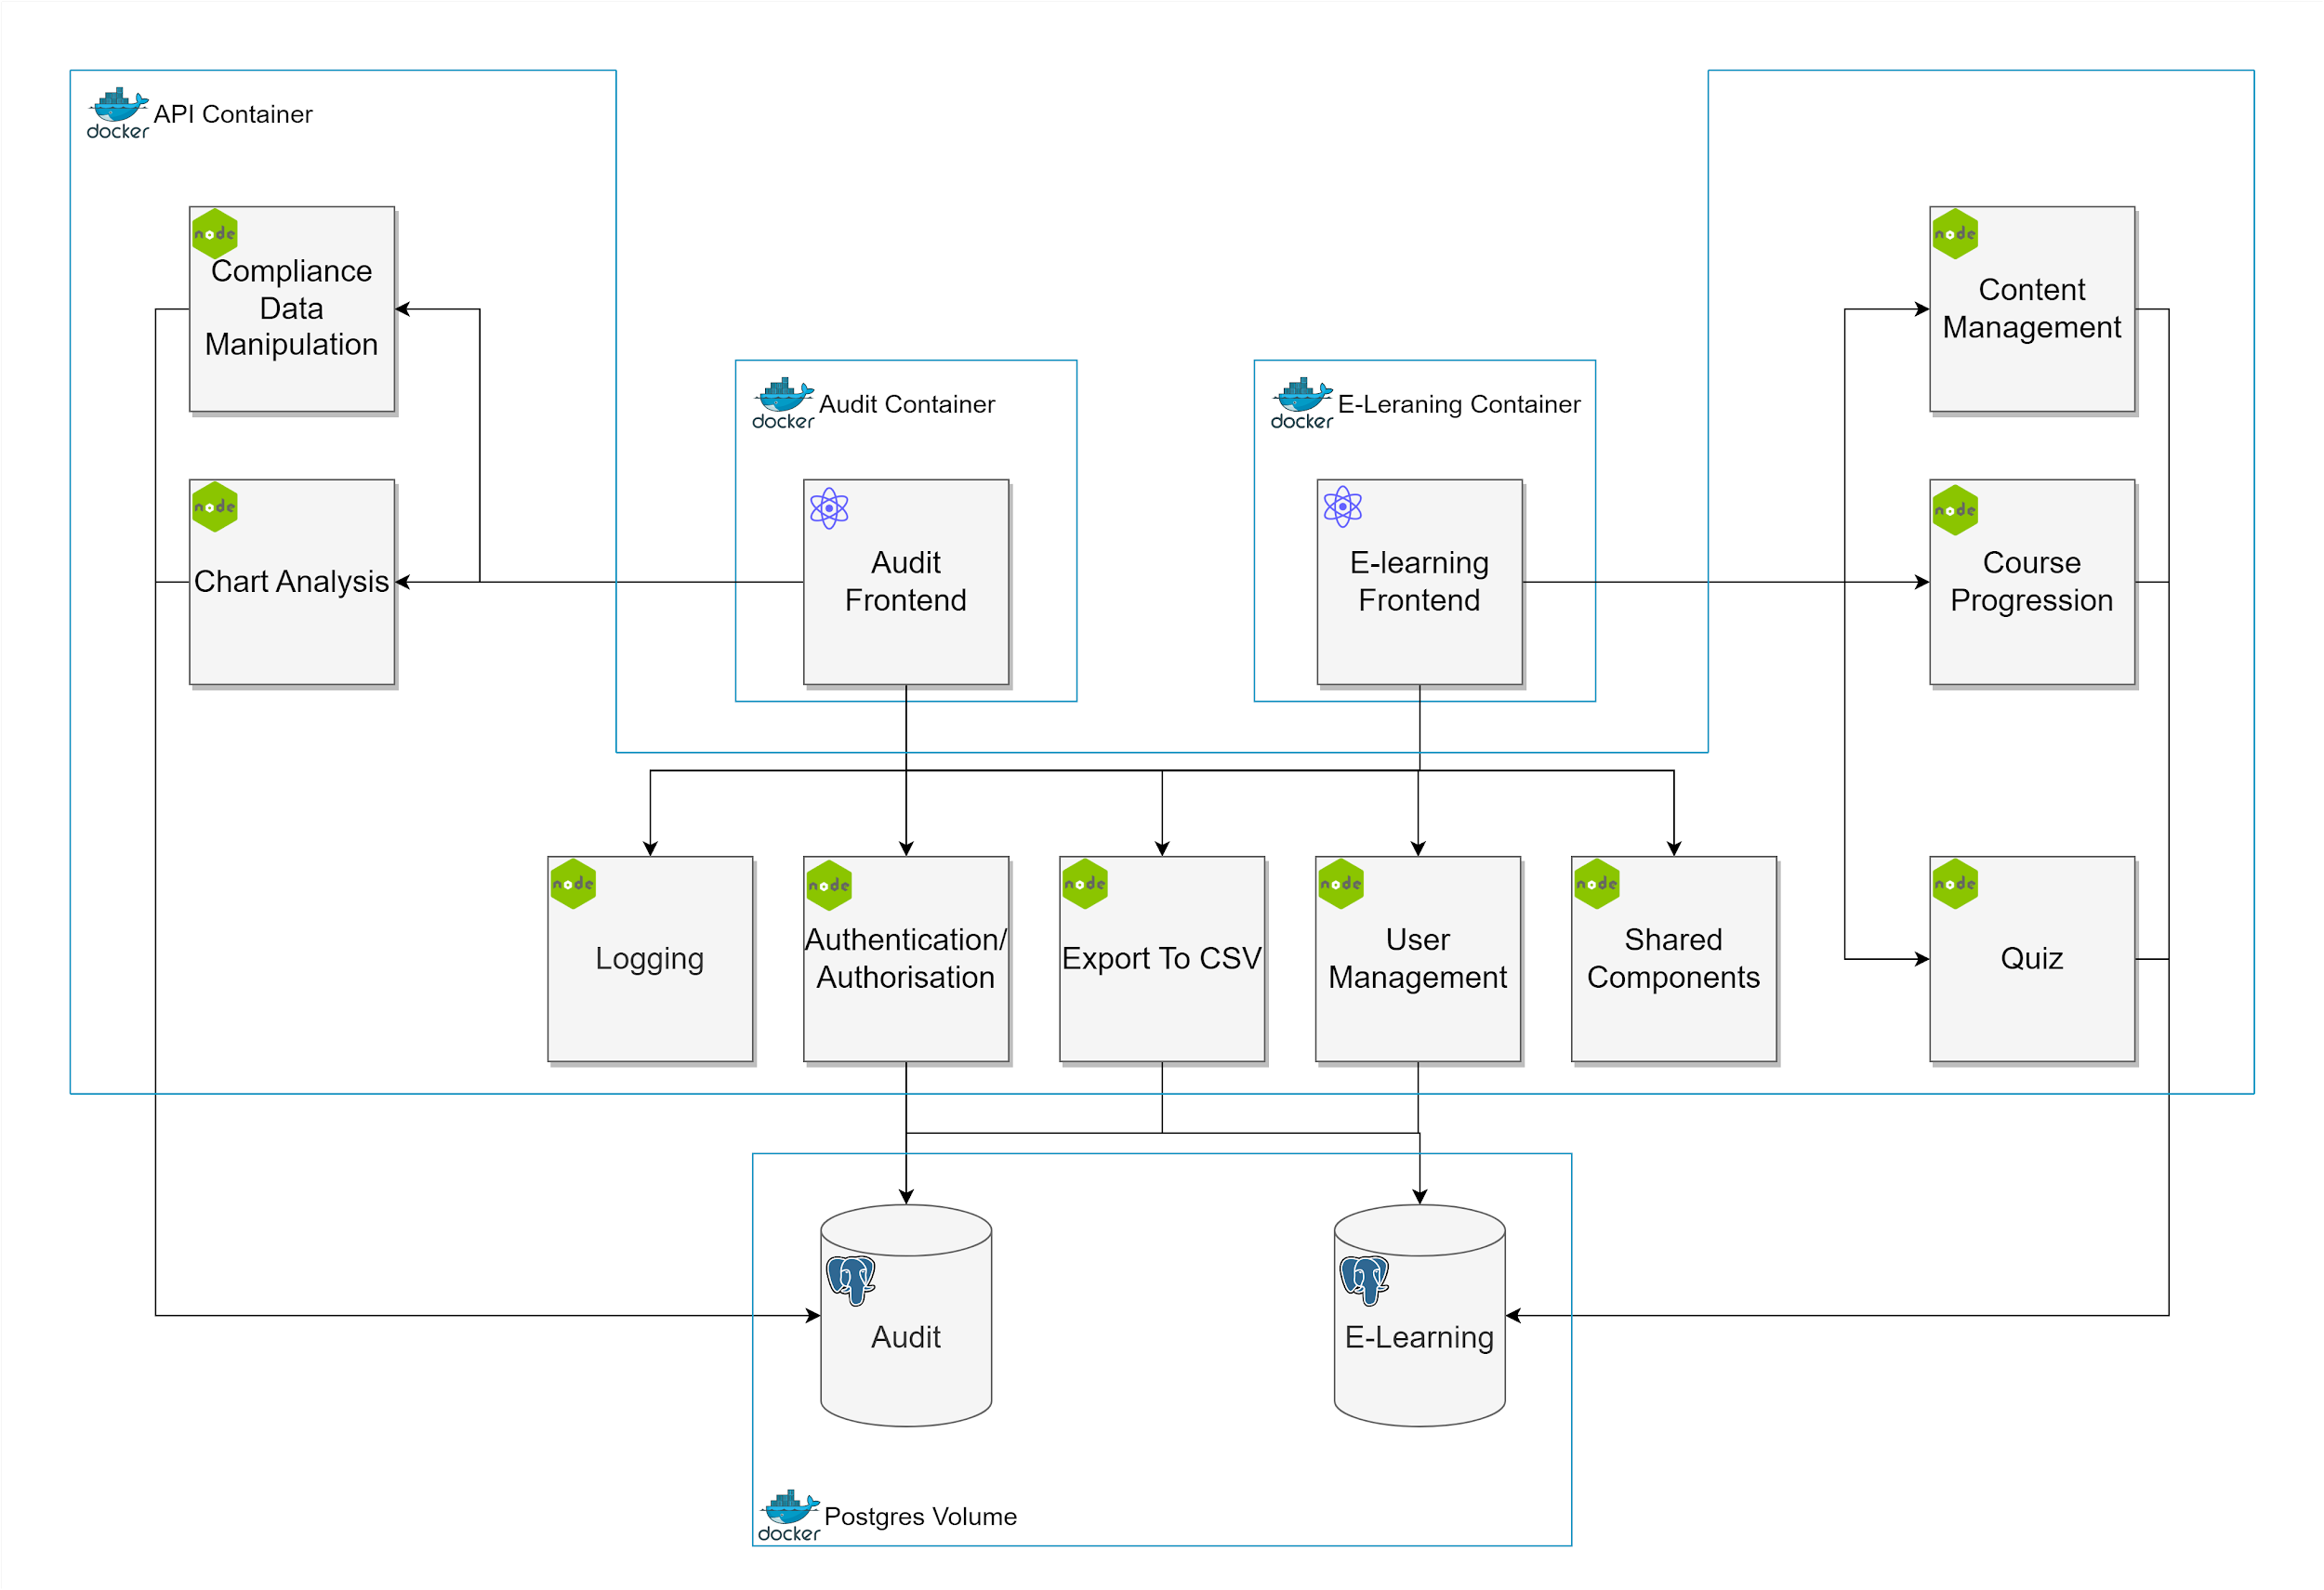
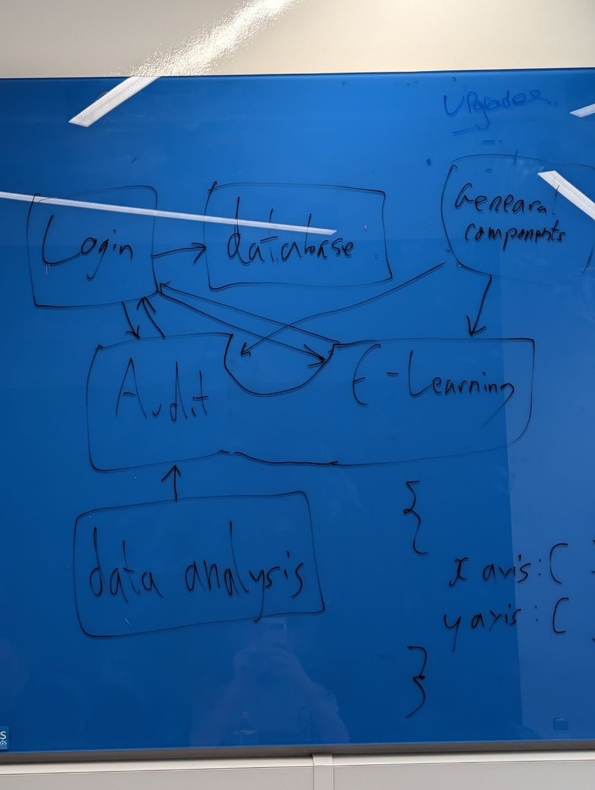
Block Diagrams
Notes:
We have chosen to adopt a service oriented architecture
Each ‘block’ represents a service within the system, which performs a unique business task
You can see from the diagram the technology used for each service (APIs nodejs, frontend react and database is postgres
The postgres server is required to be a volume to share it’s contents across multiple instances of containers

Slide 9
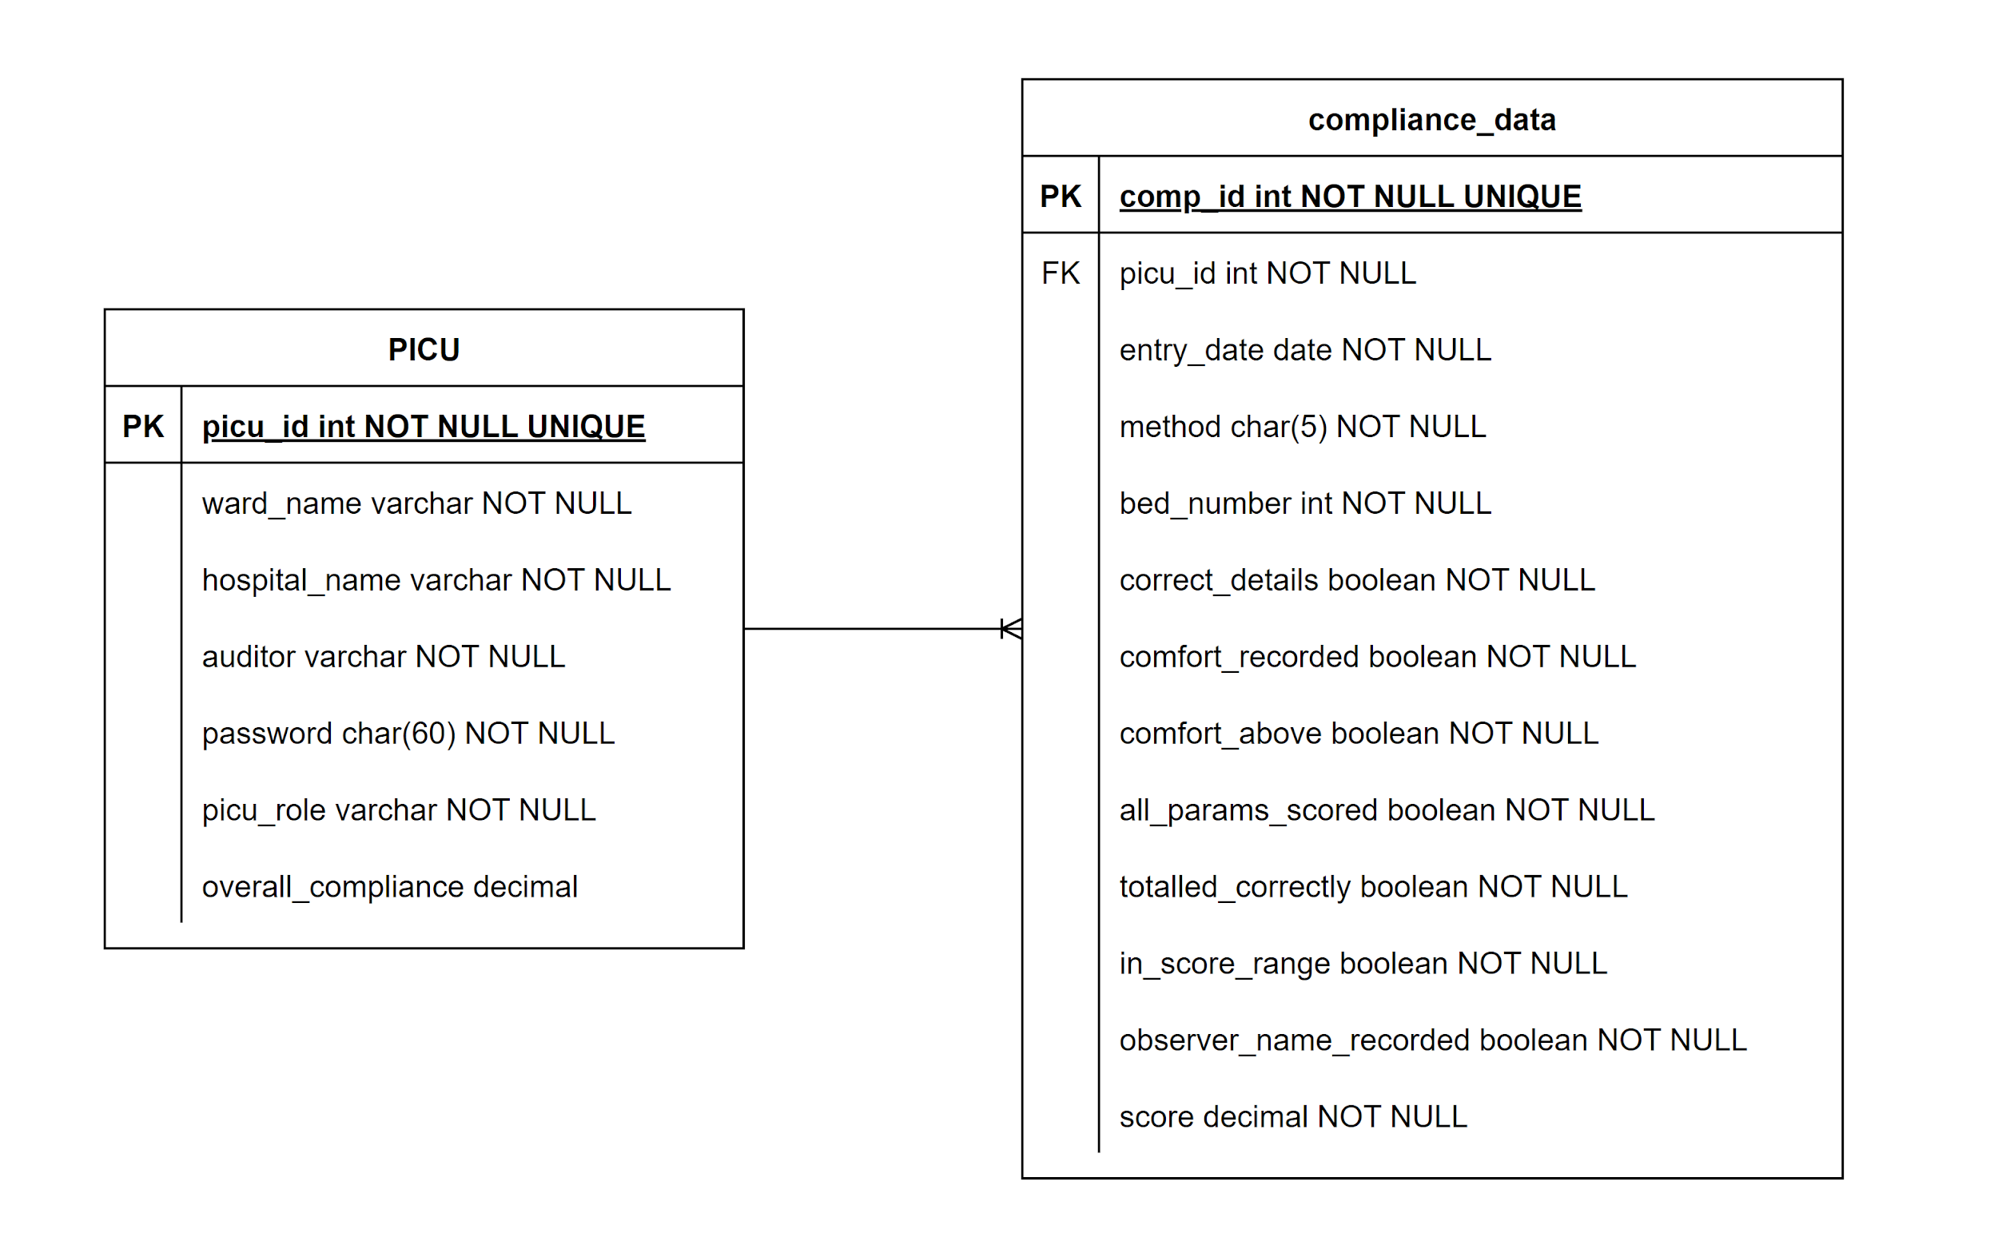
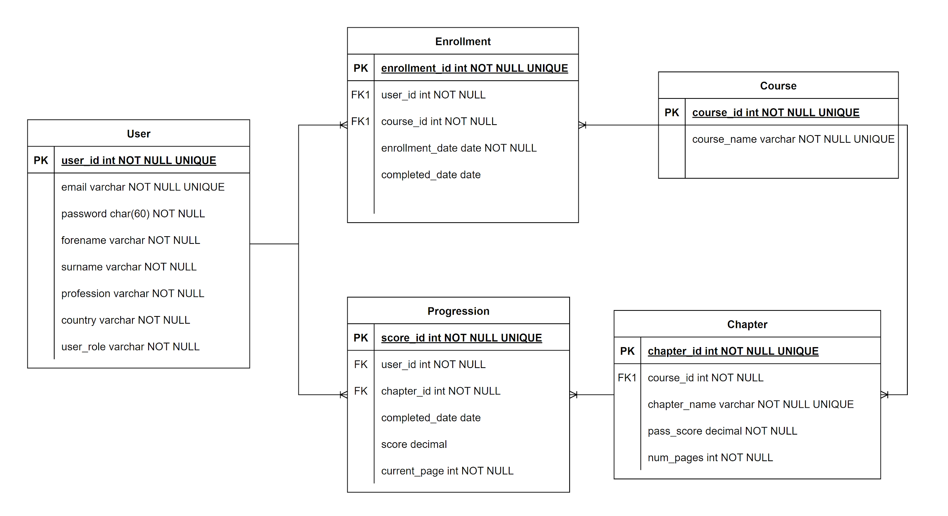
ER Diagrams
The below diagram was constructed from both the information the client wished to capture and to achieve the technical requirements
E-Learning Database
Audit Database
The information above was taken from the Excel spreadsheets used in the current audit system
Notes:
Our E-Learning database is designed to hold telemetry data based on the users and other data such as their position in the content and chapters.
Our audit database is based off of the spreadsheets currently in use and is designed to take some of workload off the nurses.
Both databases also store the login data for their own system.

Slide 10
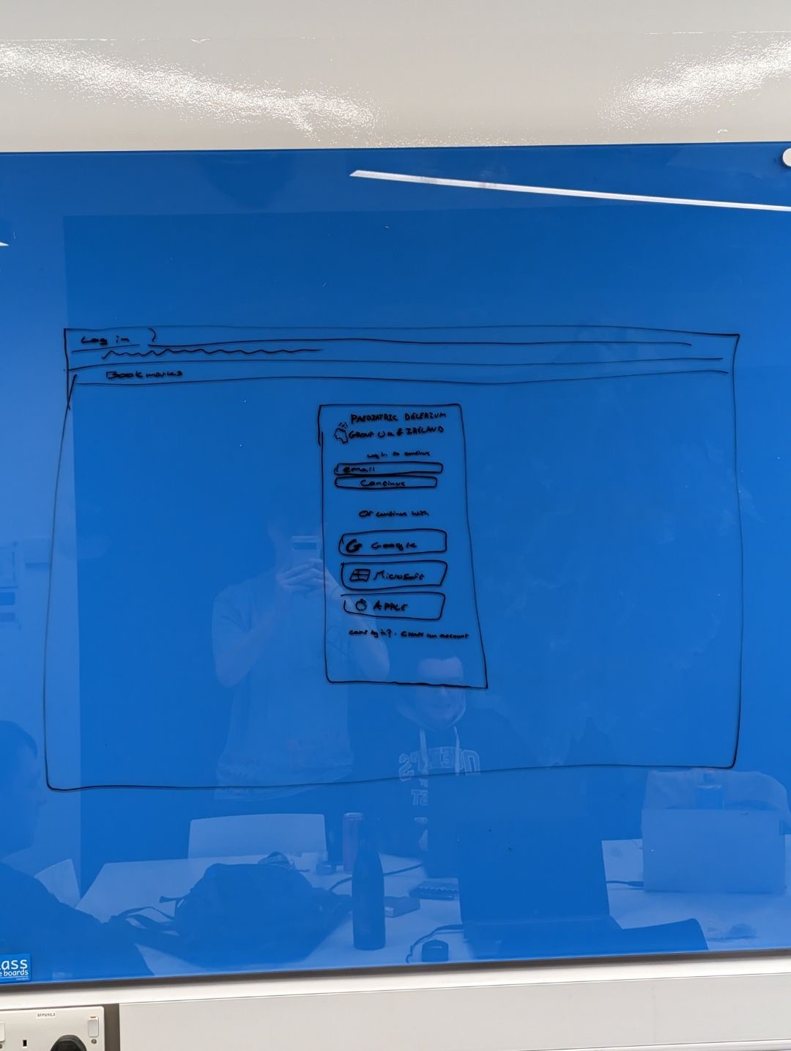
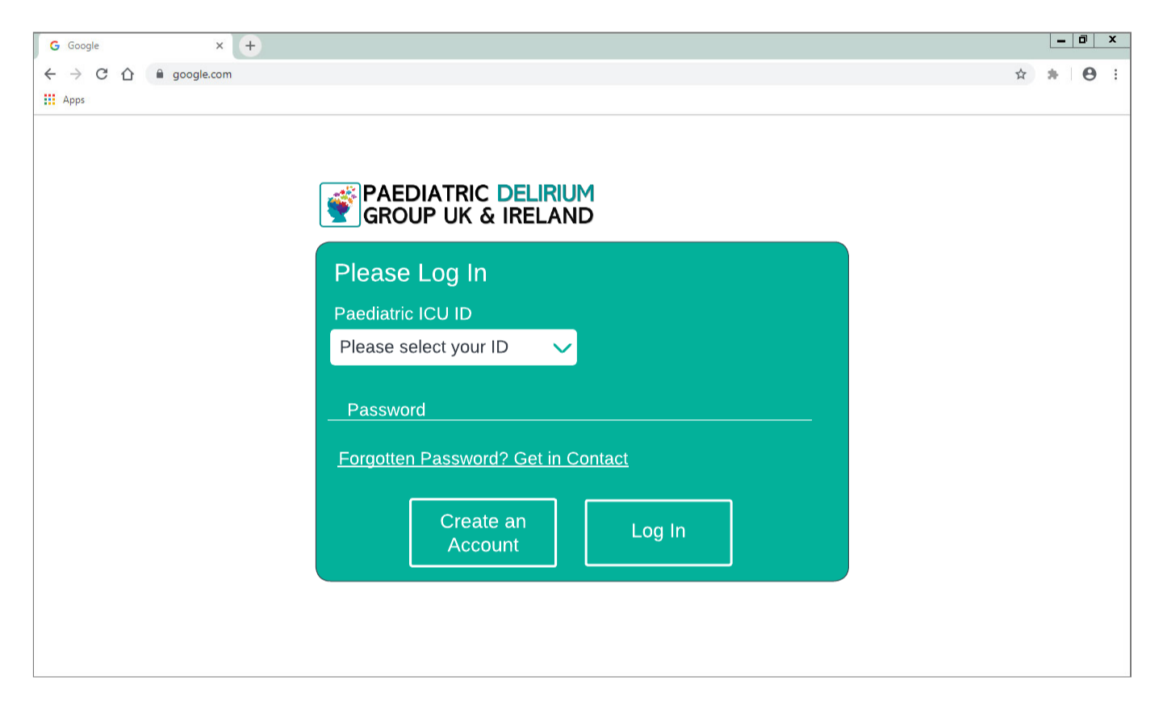
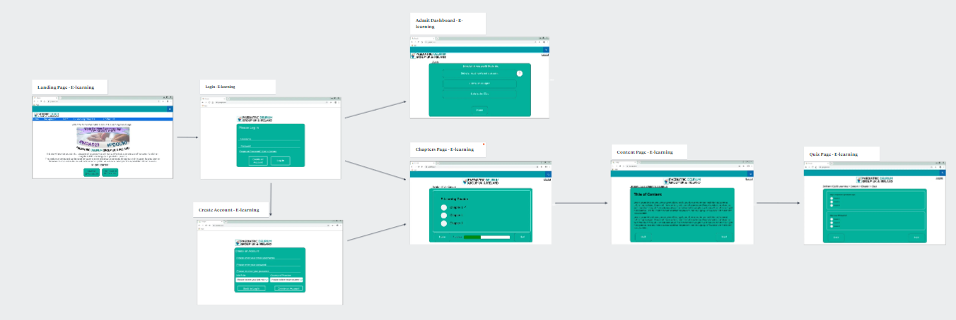
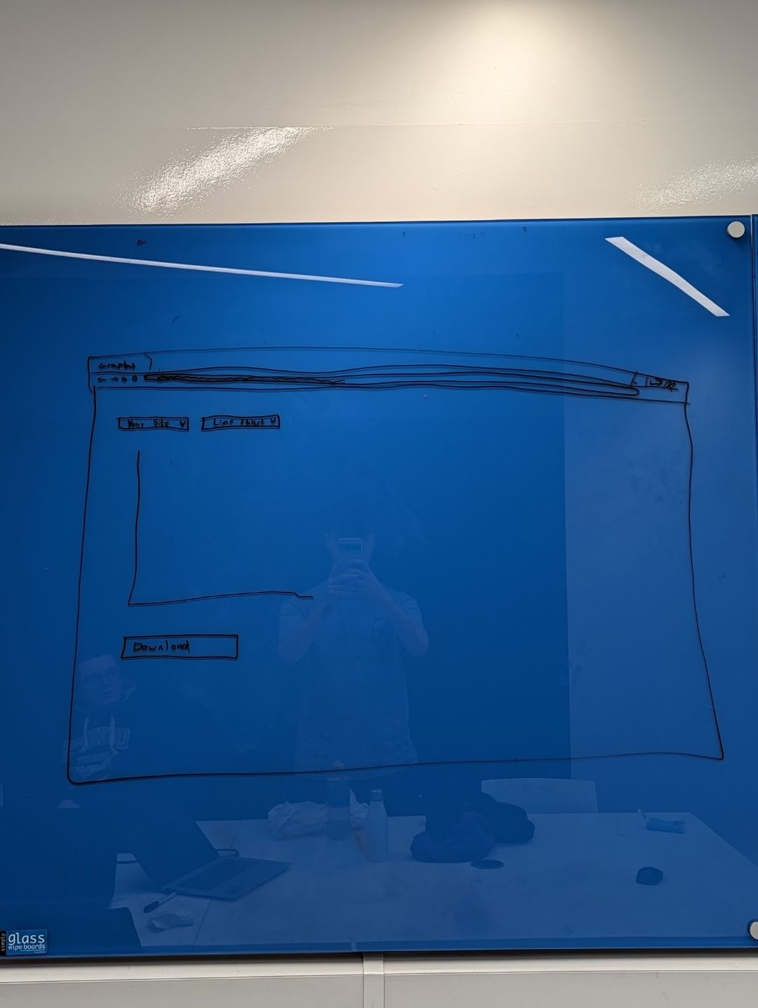
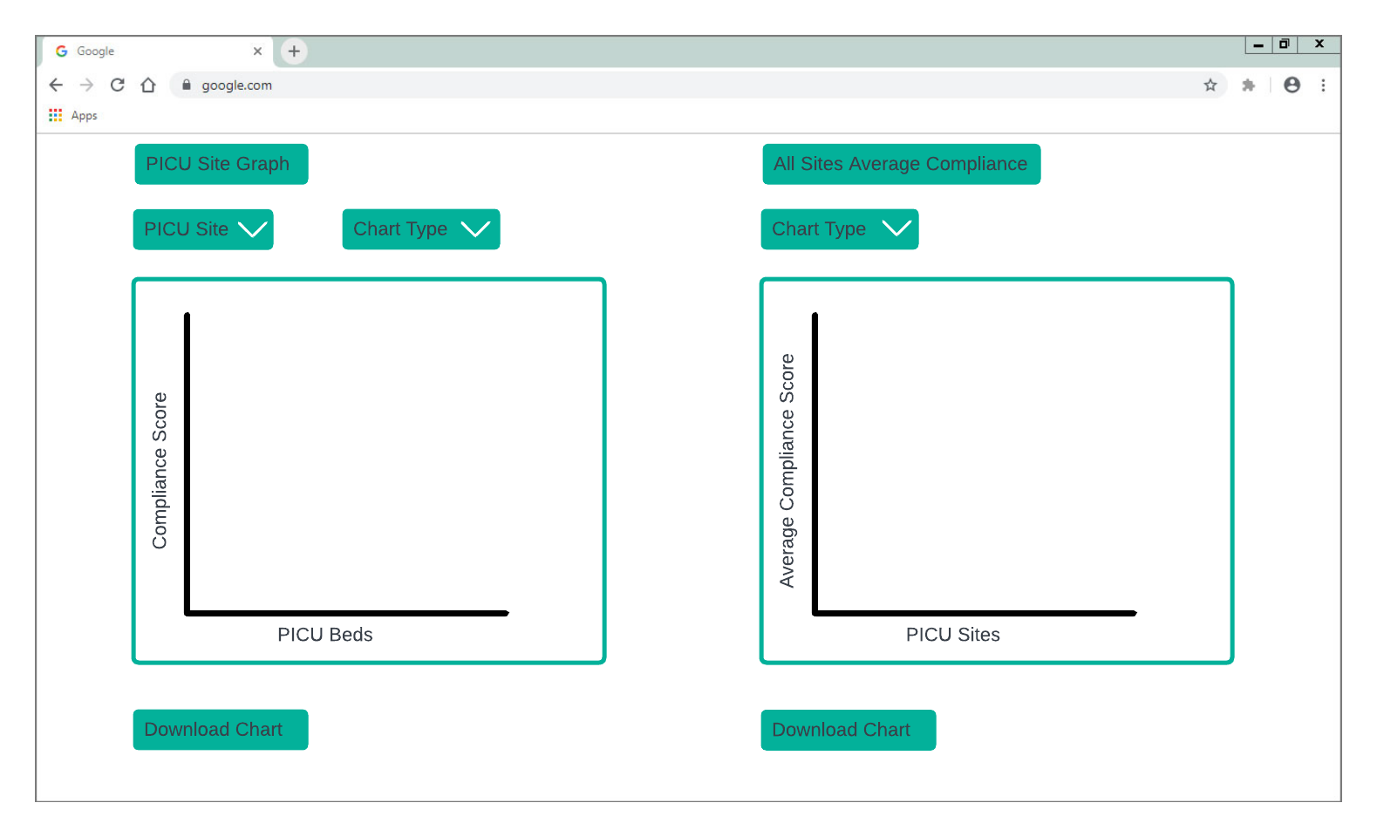
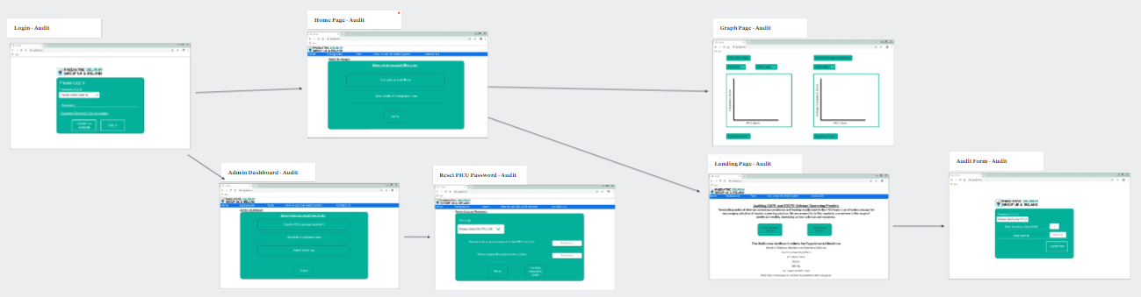
Wireframe Diagrams
Audit Wireframes
Link To Storyboard
Overview of Storyboard
This is our original and digital wireframes for our Audit log in page
This our original and digital wireframes for the Audit graph pages which has since changed due to requirement changes
Notes:
Design of wireframes and current design for pages is based off of the design chosen by the client which is a pre-existing brand and has been used to keep in line with our requirements

Slide 11
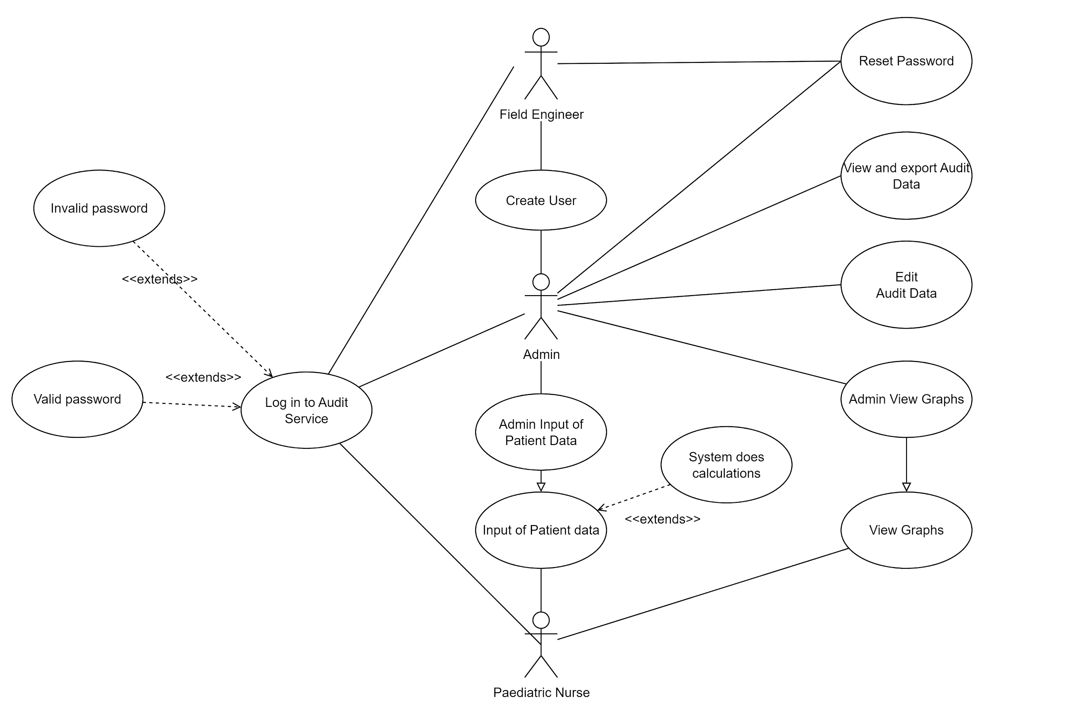
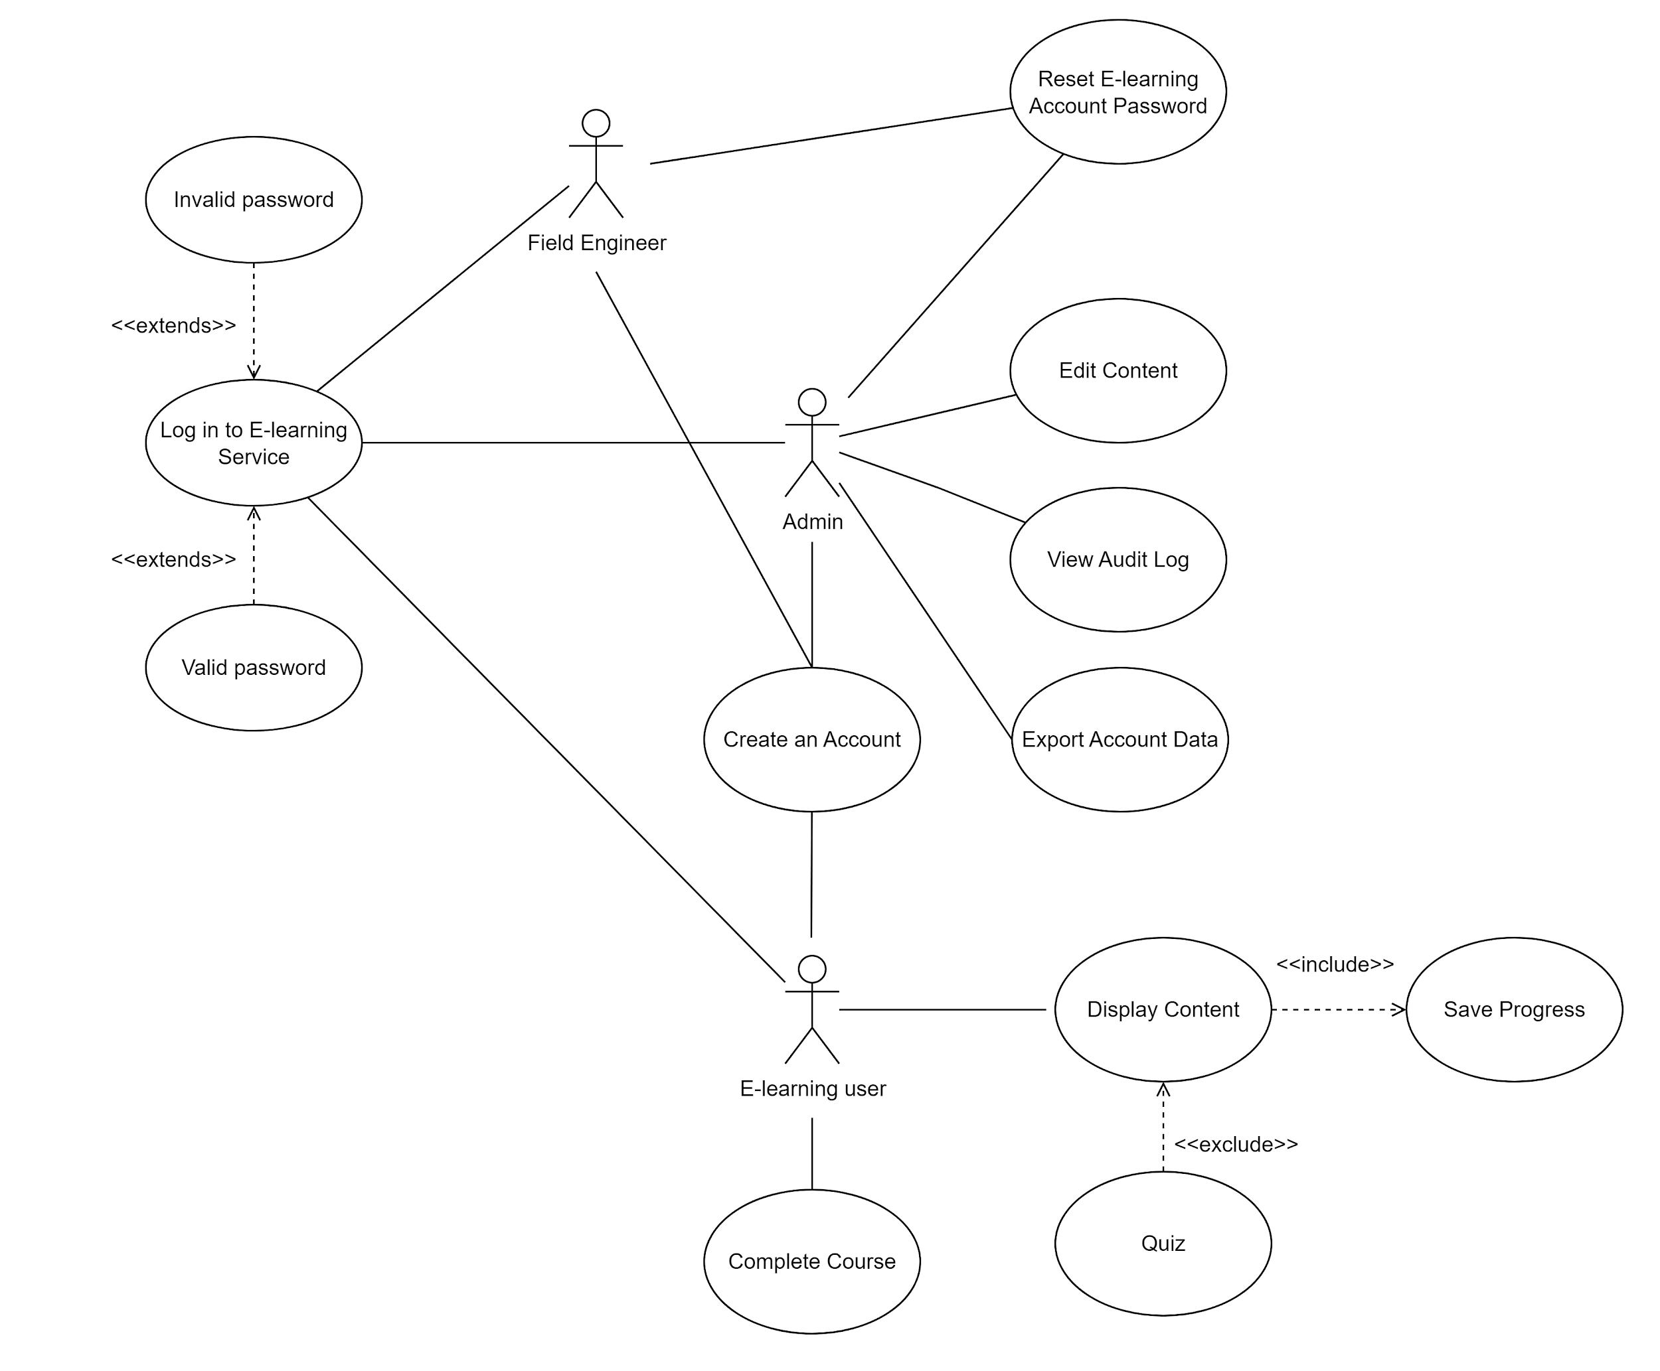
Use Case Diagrams
This use case Diagram for the E-Learning system was based off of the pre-existing Sandwich E-Learning course
E-Learning Use Case Diagram
Audit Use Case Diagram
This use case Diagram for the Audit system was based of the requirements provided by the client
Notes:
The use case diagrams are designed to be show the standard paths a user will take through the respective systems, whether it be a normal user, an admin or a field engineer.

Slide 12
03
Implementation

Slide 13




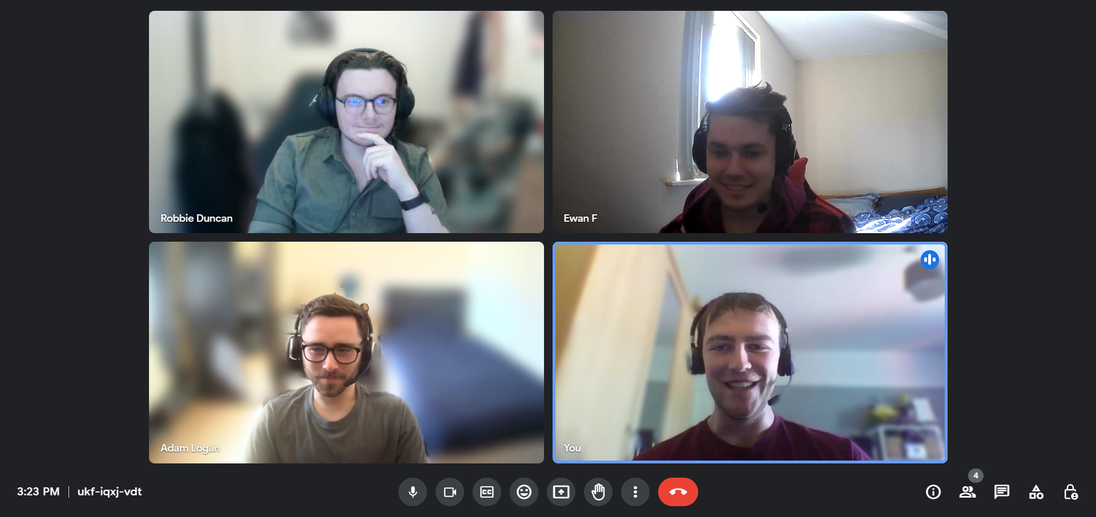
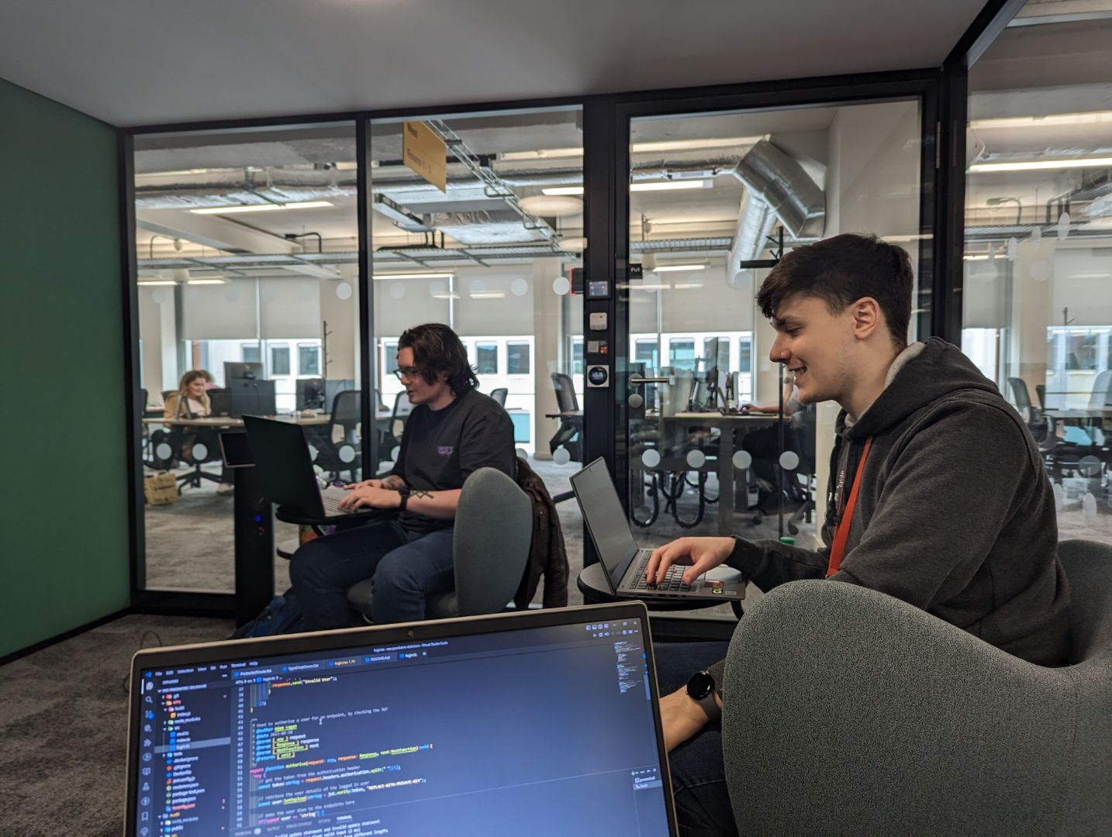
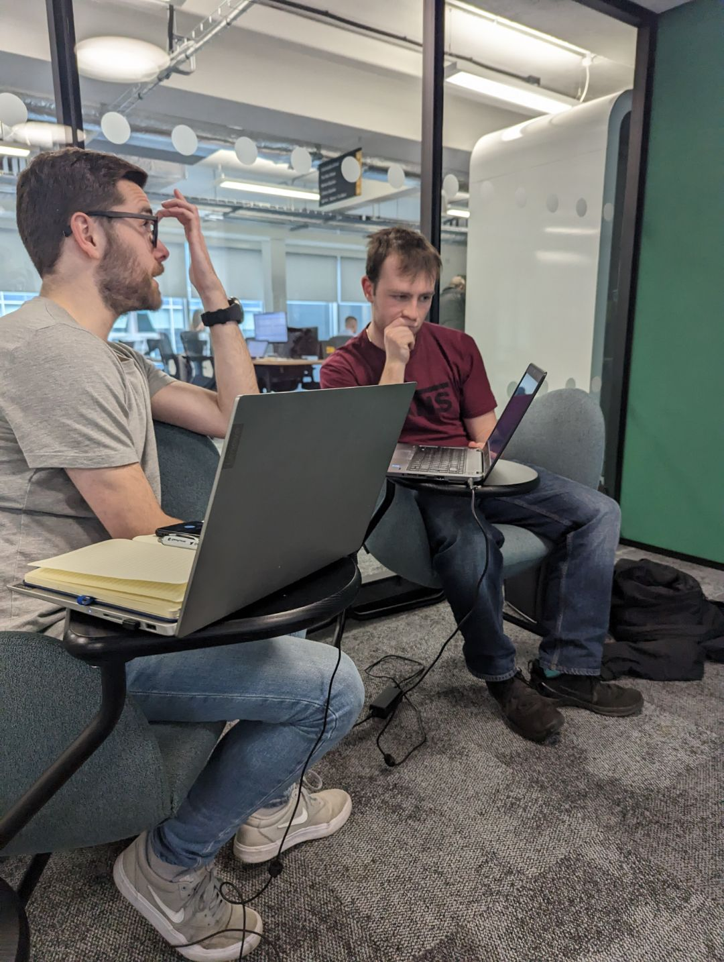
Working Together
Key Items:
Team contract
Create Expectations
Use a software for project management
Previous Experience
Delegate Tasks
Use of Gitlab
Collaborating on code
Branching/Merging
Use of G Suite
Previous Experience
Organisation of documents and meetings
In-Person Meetings
Report Collaboration
Peer Programming
Group Learning Environment
Notes:
Team Contract
By doing this we are creating expectations that the whole team has agreed are appropriate and believe they can abide by.
Use a software for project management
Currently Jira is the software project that we have chosen as team members have had previous experience using this on placement.
We used a g suite and GitLab to collaborate throughout the project
In-Person peer programming
Pwc building and CSB

Slide 14
Description of features
Reason for prioritisation
Audit System
Login System
Data Input
CRUD
Data Visualisation
Implemented a RBAC system with user’s password being hashed
Compliance Data can be entered into the system through a form in the application
Basic CRUD endpoints were made to ensure connection to database
Displays the Audit Data in the Database as a Line Chart in the web application
Basic functionality of the system
Sets up the groundwork for a working system
Majority of requirements are within the Audit system and therefore the focus was put onto this
Notes:
For the prototype we wanted to focus on the login, the database including data input and connections and data visualisation.
We prioritised these features to achieve a basic functionality and provide a groundwork for the future development of our system.
We focused on the Audit system of our project due to the majority of our requirements being within that system over the E-Learning system.

Slide 15

Problems Encountered
GitLab Set Up
CORS
The Server
Acquiring SSH keys to connect to GitLab was a challenge
Although a security feature this hindered initial development
Issues with access rights
Chart.js
Database Set Up
The differences between how packages act with React and JavaScript
Problem with ensuring consistency across development environments
Notes:
Database initial setup
A script was required to allow for the creation of the separate databases when docker starts the containers
A key issue with this was the fact that the script itself was written on a Windows machine and therefore the format was required to change to run on the linux VM docker uses
As the contents of the database are not shared through git a script was made to reset the database when a developer launched the containers, to provide consistency for development and testing
Chart.js
A disadvantage of our choice to use react over vanilla javascript was shown here as the majority of resources were for the vanilla chart.js over react-chart.js
Adding the react app to the EEECS server
Due to the access restrictions we were unable to run docker and therefore launch our application
Originally we struggled to get access to the server but managed to work through the problem by working together and research

Slide 16
04
Prototype Demo

Slide 17
WHOA!
Now we will give a live demonstration on the functionalities in our prototype implementation.

Slide 18
05
Summary

Slide 19
SUMMARY
What we have covered:
What is the problem?
What is our proposed solution?
Our system design process
Our system design diagrams
How we have worked together
Features implemented
Reasons for prioritisation
Live prototype demonstration

Slide 20
THANKS FOR LISTENING!
ANY QUESTIONS?

